Slide 1


Pakistan Stcok Market Prediction
AI-FEST
Project Evaluation
Muhammad Shahmir Khan
Kashish Khatri
Madiha Paracha
Instructor: Zahid Hussain
Industry Partner: Muhammad Jahangir Khan
Department of Computer Science - DHA Suffa University

Slide 2


Summary
Project Brief Introduction
Problem Statement
Dataset Description
Project Scope
ML/DL/NLP Model Details
Results and Discussions
Tools and Technologies Learnt During the Project Implementation (Individual Skills Set)
Project Demo
References (last accessed)
Can have
maximum 20 slides.
If you want to add any other slide other than this you can but listed heading are required.

Slide 3
Project Brief Introduction
The Pakistan Stock Market, represented primarily by the Karachi Stock Exchange, is a critical component of the country's financial system. Accurate prediction of stock market trends in Pakistan is invaluable for investors, traders, and financial analysts. This can lead to more informed decision-making, optimized investment strategies, and reduced financial risk.

Slide 4
Problem Statement
Develop a predictive system for stock prices using historical data, financial indicators, and machine learning algorithms to provide valuable insights and accurate forecasts for informed investment decisions.

Slide 5
Dataset Description
We have taken the dataset from Zeeshan-ul-Hassan Usmani's profile on Kaggle, where he has data from 2008 to 2021.
Where he has compiled and uploaded the KSE 100 index data.
https://www.kaggle.com/datasets/zusmani/pakistan-stock-exchange-kse-100

Slide 6
Project Scope
The scope of Pakistan stock market prediction includes:
Individual and institutional investment decisions
Research and analysis
Financial planning and wealth management
Corporate decision-making and economic policy-making
Risk management and portfolio optimization
Algorithmic trading and market analysis
Helping to help grow and develop Pakistan's financial markets.

Slide 7
ML/DL/NLP Model Details
Data Preparation: Interactive collection of sales data including date, item category, specific item, quantity sold and unit price.
Processing: Sorting date, calculating days since earliest entry and prparing features and target variable.
Random Forest Model: Utilizes random forest regressor to learn relationships between day and sale.
Sales Forecast: Both models forecast sales for next 7 days, adjusted for realism.

Slide 8
Results and Discussions
It includes:
Average Sales Amount: The mean sales amount calculated from the user input data.
Most Used Items: The item with the highest frequency of occurance in the dataset.
Average Sale per Category: The mean sales amount for each category, offering insights into category-wise sales performance.

Slide 9
Tools and Technologies Learnt During the Project Implementation
Programming Languages: Python
Libraries and Frame work: Scikit-learn, Pandas, NumPy, Matplotlib, Seaborn, Plotly etc.
Data Sources: Pakistan Stock Exchange (PSX) data, Quandl, Yahoo Finance.
Data Preprocessing Tools: Pandas, NumPy, Matplotlib, Seaborn, Scikit-learn.
Visualization Tools: Matplotlib, Seaborn, Plotly.
Other Tools: Git, Jupyter Notebook, Google Colab.

Slide 10
Project Demo
Welcome to our Pakistan Stock Market Prediction Demo! Our project uses machine learning to predict stock prices on the Pakistan Stock Exchange (PSX), providing valuable insights for investors and stakeholders. This demo showcases our predictive model's features, accuracy, and potential impact on investment decisions.
Our dashboard displays real-time stock prices, predictions, and historical data for various stocks listed on the Pakistan Stock Exchange (PSX).

Slide 11
Project Demo
Fearures:
Stock Price Prediction: Enter a stock symbol to generate a predicted price for the next trading day.
Historical Analysis: View historical stock prices, actual vs. predicted prices, and accuracy metrics.
Portfolio Manager: Create a sample portfolio to see how our predictions can help you make informed investment decisions.

Slide 12
Project Demo
How to use:
Select a stock symbol from the dropdown menu.
Click "Predict" to generate a predicted price for the next trading day.
View historical data and accuracy metrics.
Create a sample portfolio to see how our predictions can help you make informed investment decisions.

Slide 13
Project Demo
Conclusion:
Our Pakistan Stock Market Prediction project aims to provide accurate and reliable predictions to support informed investment decisions. We believe our predictive model can be a valuable tool for investors, financial analysts, and stakeholders in the Pakistan stock market.

Slide 14
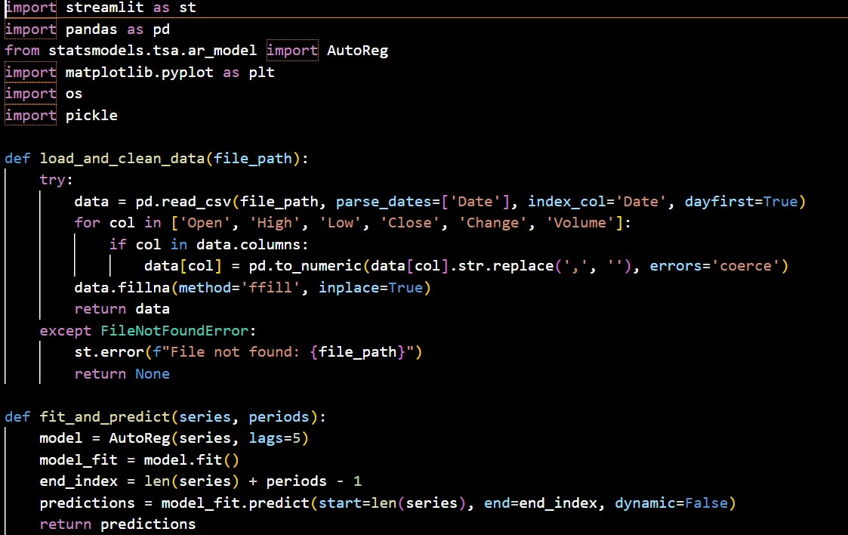
ScreenShots of Code

Slide 15
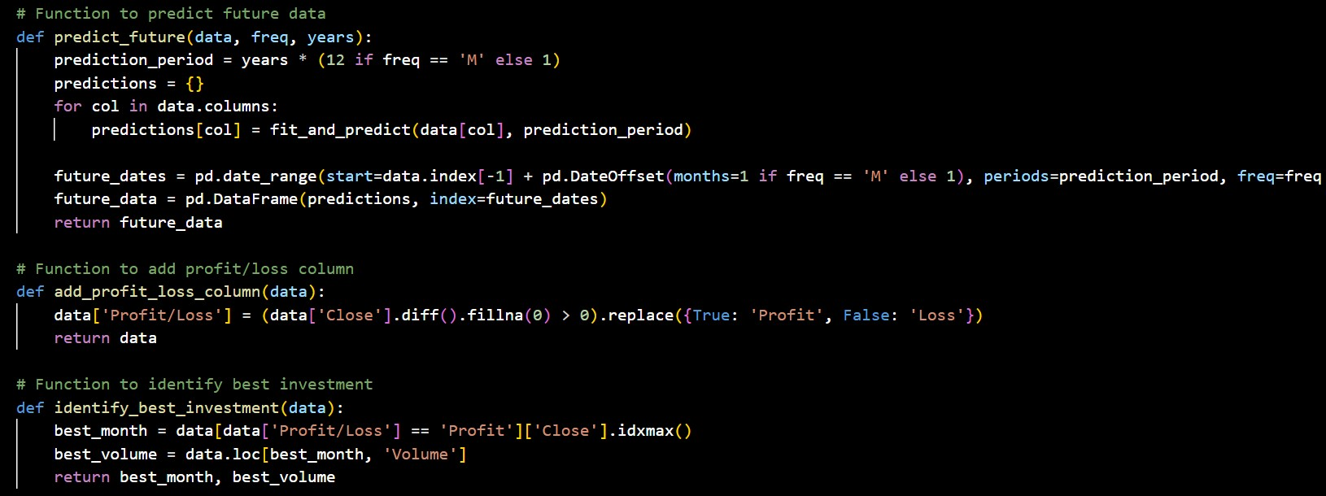
ScreenShots of Code

Slide 16
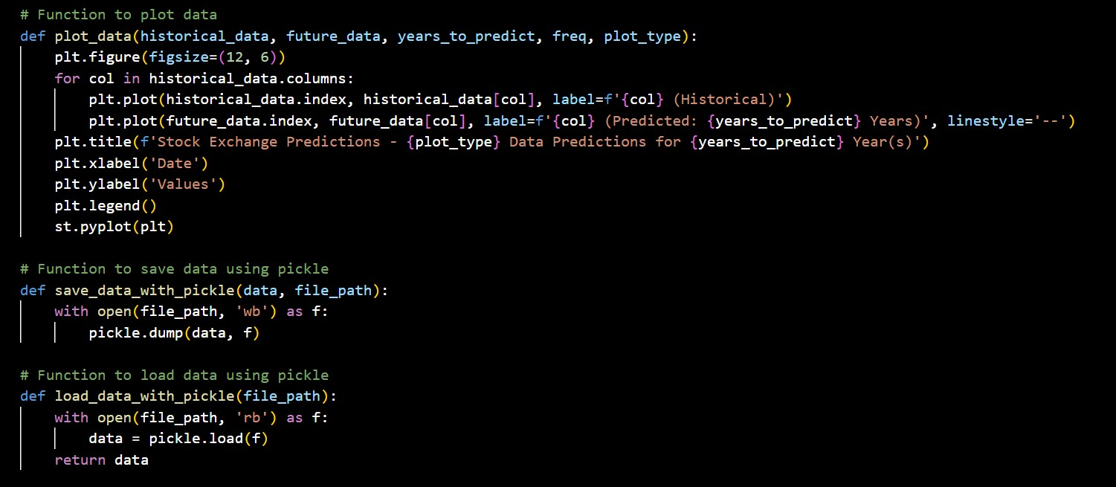
ScreenShots of Code

Slide 17
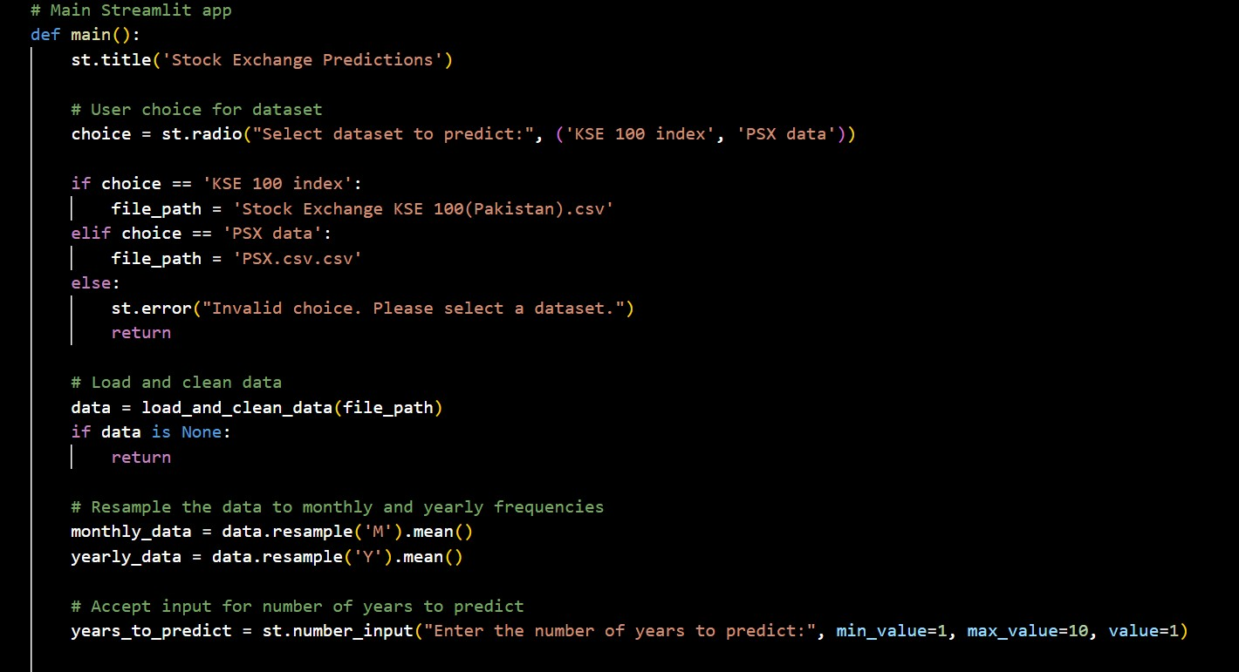
ScreenShots of Code

Slide 18
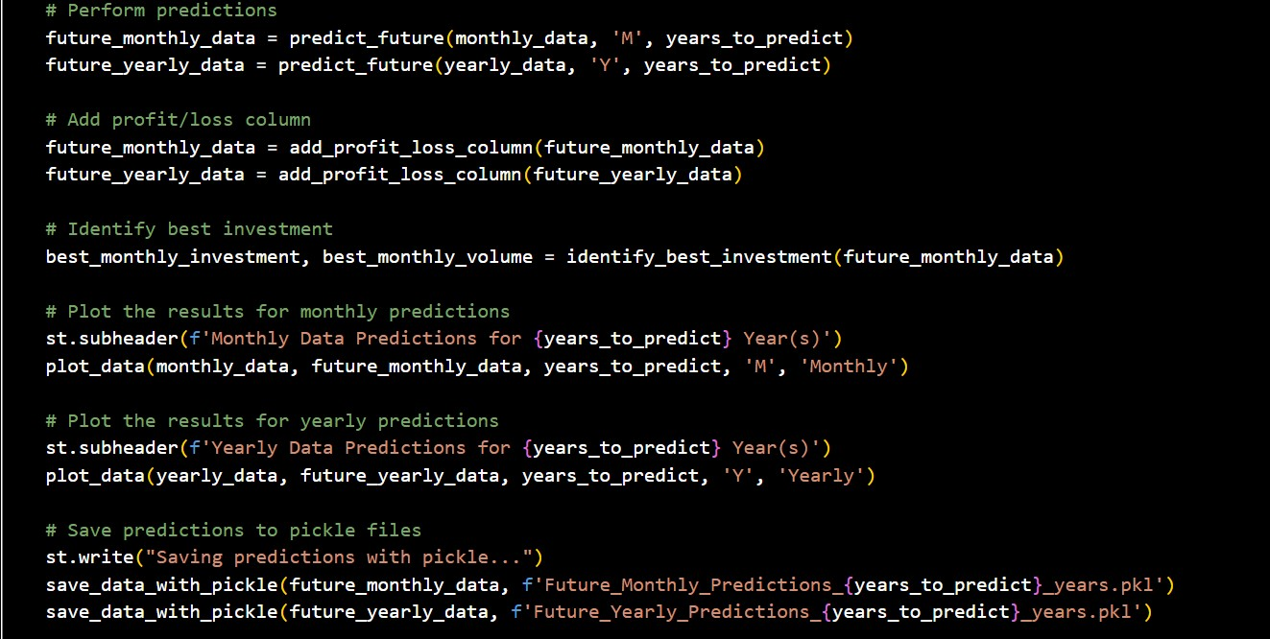
ScreenShots of Code

Slide 19
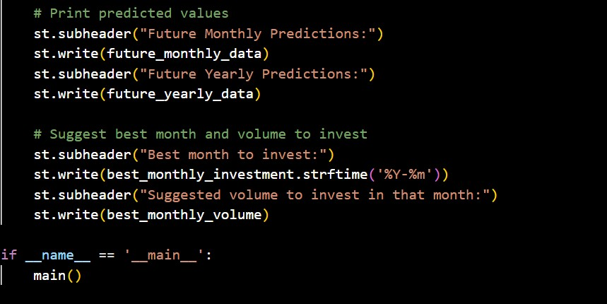
ScreenShots of Code

Slide 20
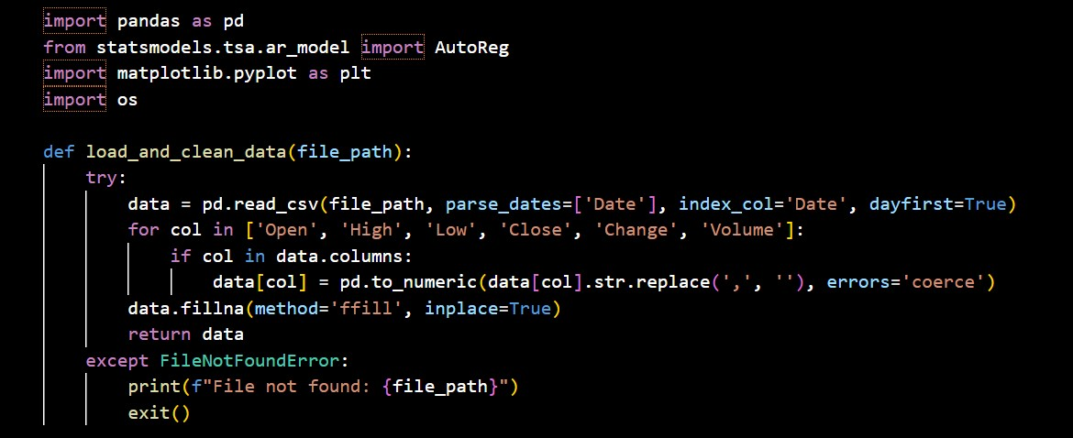
ScreenShots of code

Slide 21
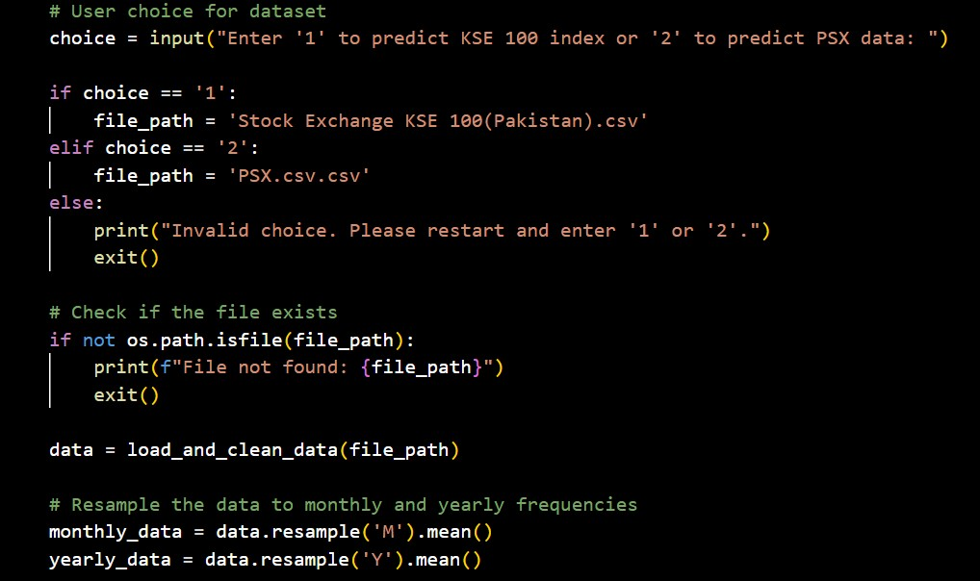
ScreenShots of code

Slide 22
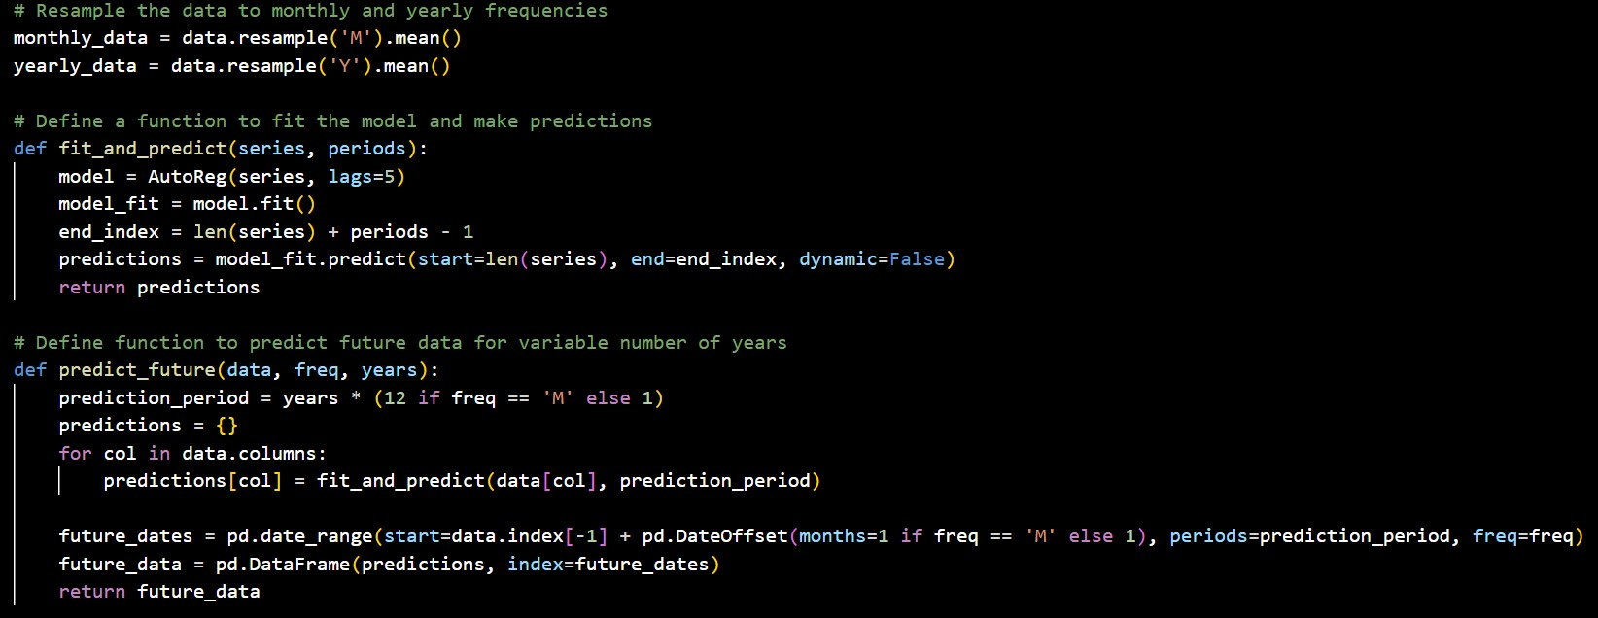
ScreenShots of code

Slide 23
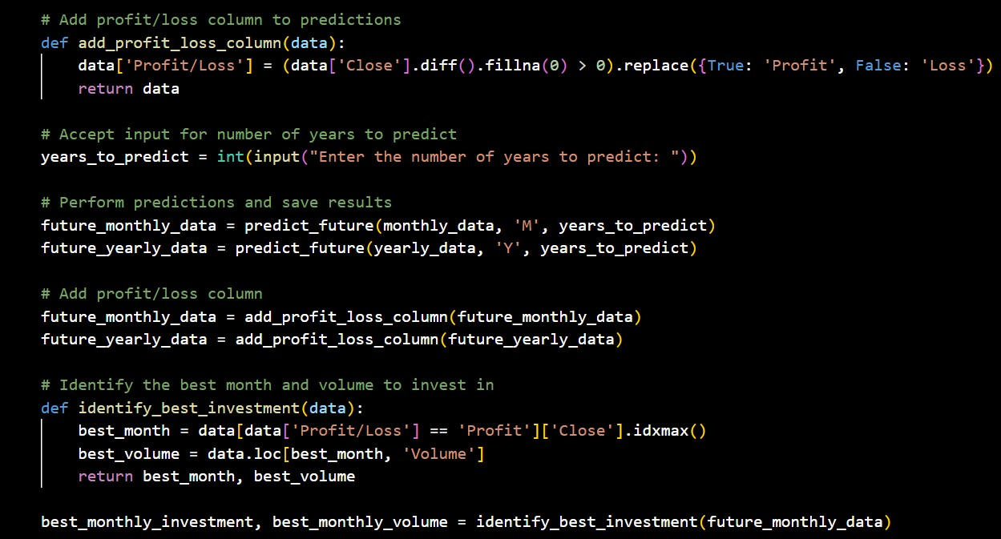
ScreenShots of code

Slide 24
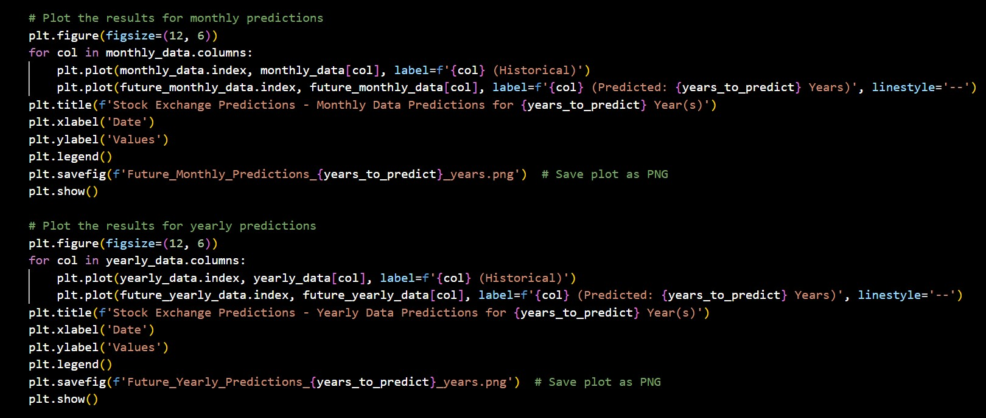
ScreenShots of code

Slide 25
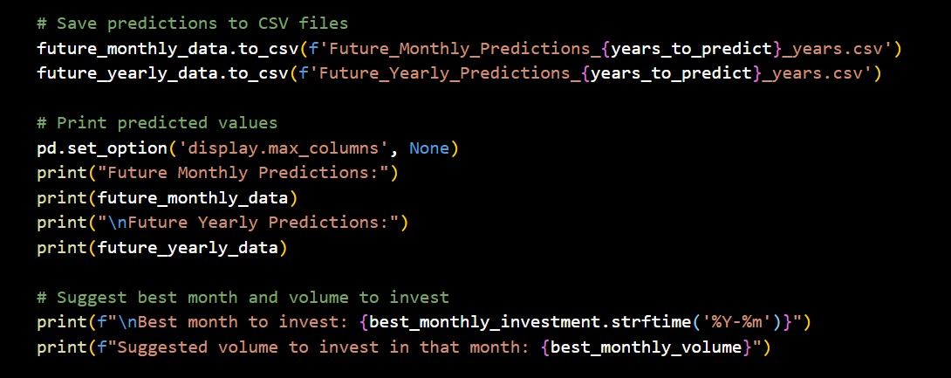
ScreenShots of code

Slide 26
8- Reference
Use Chicago style of referencing
Examples
Book reference
Pollan, Michael. The Omnivore’s Dilemma: A Natural History of Four Meals. New York: Penguin, 2006.
Website reference
Google. “Google Privacy Policy.” Last modified March 11, 2009. http://www.google.com/intl/en/privacypolicy.html.
McDonald’s Corporation. “McDonald’s Happy Meal Toy Safety Facts.” Accessed July 19, 2008. http://www.mcdonalds.com/corp/about/factsheets.html.
Journal reference
Weinstein, Joshua I. “The Market in Plato’s Republic.” Classical Philology 104 (2009): 439–58.

